Slide 1

GBUS-720-001, Marketing Analytics Final Project: Car Seats Sales Prediction
Ama Sefaa Bempong Ampomah, M'hammed Amine El Boury,
Sabrine Hussein, Snehita Moturu, Carolina Torres Rodriguez
mage Source: Power Point "Designer"

Slide 2
Table of Content
Executive summary
Introduction
Analysis Methods and Results
Conclusion and Recommendations

Slide 3
Executive summary
Business Problem
Market Dynamics and Competition
Understanding Influential Factors
Development of Predictive Model
Report’s Key Points
Importance of Analytics
Benefits of Multiple Linear Regression
Role of Visual Analysis

Slide 4
Executive summary (continued)
Proposed Solution
Transition to Data-Driven Decision-Making
Identification of Key Predictors
Insights for Strategic Implementation

Slide 5

Introduction - Problem Importance
Excess inventory causes an increase in carrying costs, and a decrease in profit
Inventory shortage means lost sales opportunities and can lead to financial losses
Effective resources allocation helps reduce carrying costs and increase profit
Balancing supply and demand

Slide 6
Problem Solution - Analytics
Historical data helps identify key predictors that would deliver accurate sales prediction
Maximizing the firm's profitability, reducing costs, and mitigating risks
constantly evolving and adapting to the changing market helps to gain competitive advantage

Slide 7

Methods
Data Summary
Simulated data on sales of a specific product which is a brand of car seat
The data set is from 2013 and encompasses data about 400 stores selling these car seats
Multiple Linear Regression to identify important predictors that would help predict car seats sales. Sales is the response variable
Key Variables
Six out of eleven variables can be considered as key variables:
Income, Advertising, Price, Age
CompPrice - Price charged by competitor for comparable brand
ShelveLoc - The quality of the shelve location (Bad, Medium, Good,) for the product in the store

Slide 8
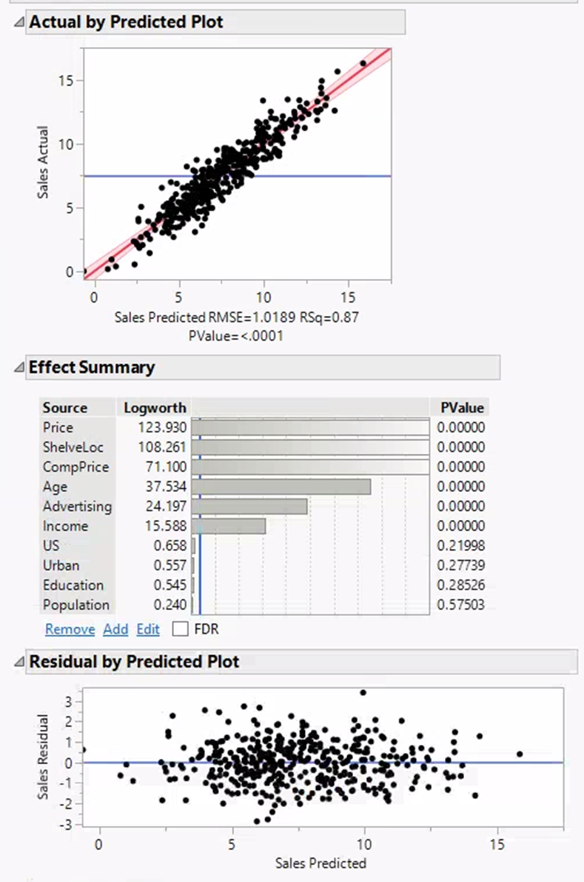
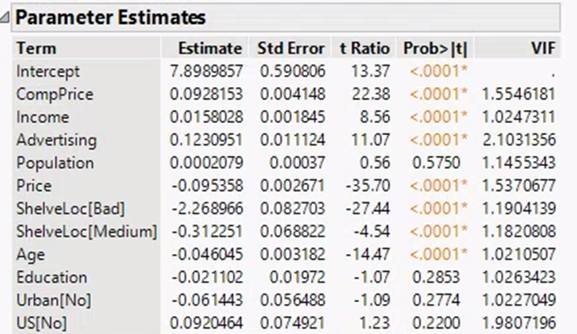
Methods (continued)
Important Visualizations
"P Values" that are larger than 0.05 indicate the variables do not have a significant impact on sales of car seats
Terms with "Prob> l t l" <0.05 indicates a variable that is significant, or a predictor that influences sales

Slide 9
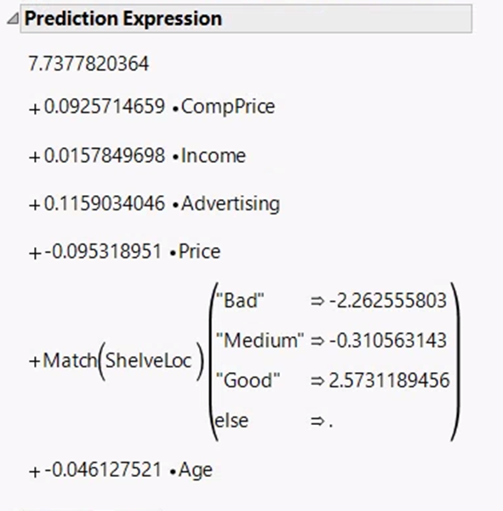
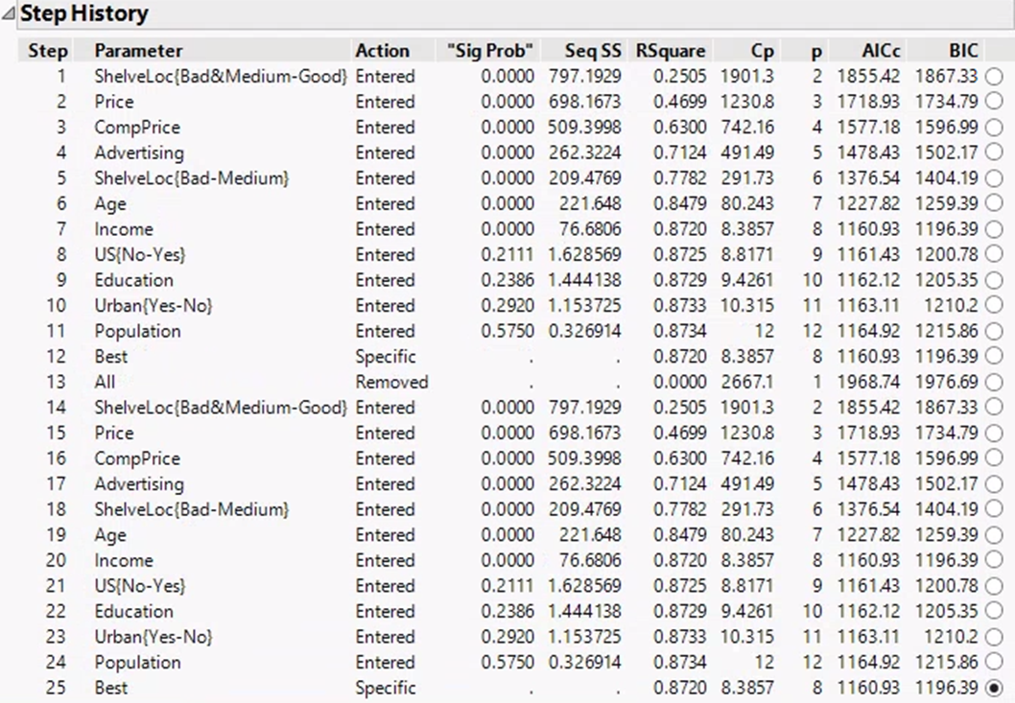
Methods (continued)
Final Model Summary
BIC starts increasing after Income, meaning all the variables following are not important for this model.
Allows us to plug values in for predicted variables to predict sales based on values for each of these variables that impact sales.
For every one unit of CompPrice that increases, we expect Sales to increase by 0.0925

Slide 10
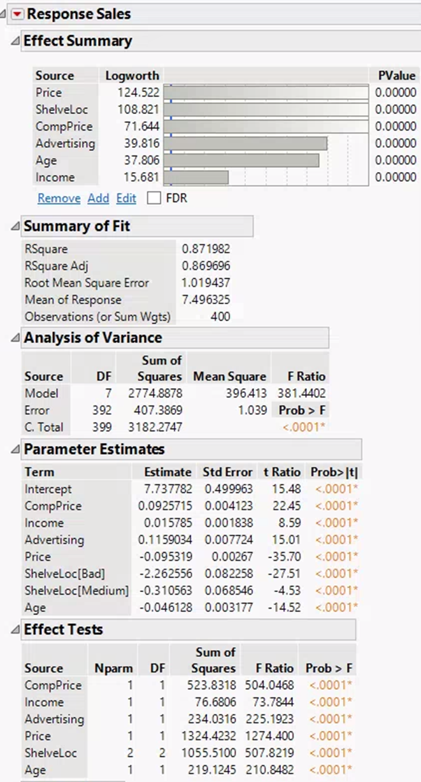
Results
Most important variables: These are the factors that have the most significant impact on the results, according to the analysis. In this case, the chart lists price, shelf location, competitor's price, advertising, age of the product, and income of the target market.
This penalizes the R-squared value for the number of variables included in the model.
The adjusted R-square is obtained to be 86.96%.

Slide 11
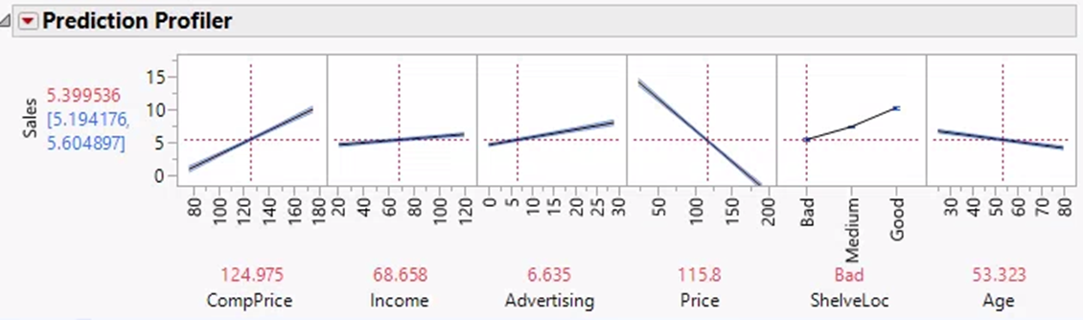

Prediction Profiler
Result (continued)
The following variables have positive relationship with Sales :
CompPrice, Income, Advertising and ShelveLoc. While Price and Age have a negative relationship with Sales
Notes:
Carolina

Slide 12

Conclusion
Summary
Identified our business problem: Predict car seat sales
Comprehensive overview of our data and the methods taken to achieve our goal
Develop a successful Multiple linear regression model
Final Results
The model is successful in predicting car seats sales
Accuracy and reliability
We can make informed decisions and optimize sales strategies to drive revenue growth
Notes:
Carolina

Slide 13
Recommendations
Long term concerns
Inherent limitations and uncertainties in predicting future sales trends accurately
Changes in consumer behavior, market dynamics, and external economic conditions could impact sales outcomes
Ongoing monitoring and recalibration of the model
Accurate data sources to avoid bias
Potential next steps
Leverage the prediction expression formula
Further refining the model by incorporating additional variables
Exploring alternative techniques to enhance the predictive accuracy
Start making data-driven decisions for the company
Notes:
Carolina

Slide 14

Appendix

Slide 15
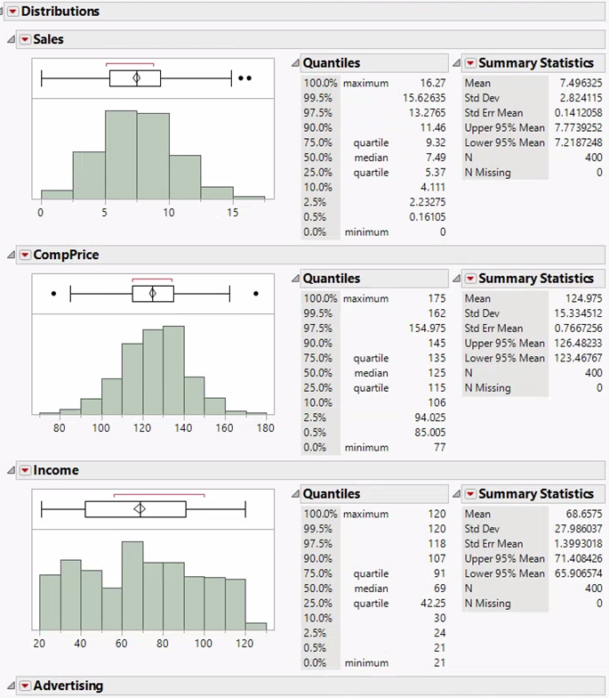
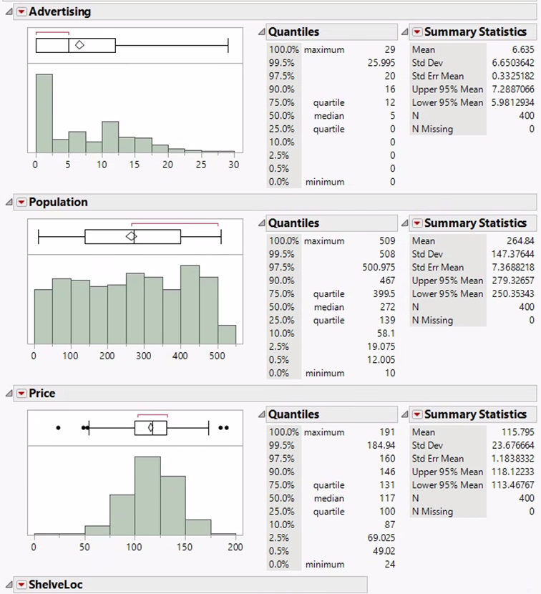
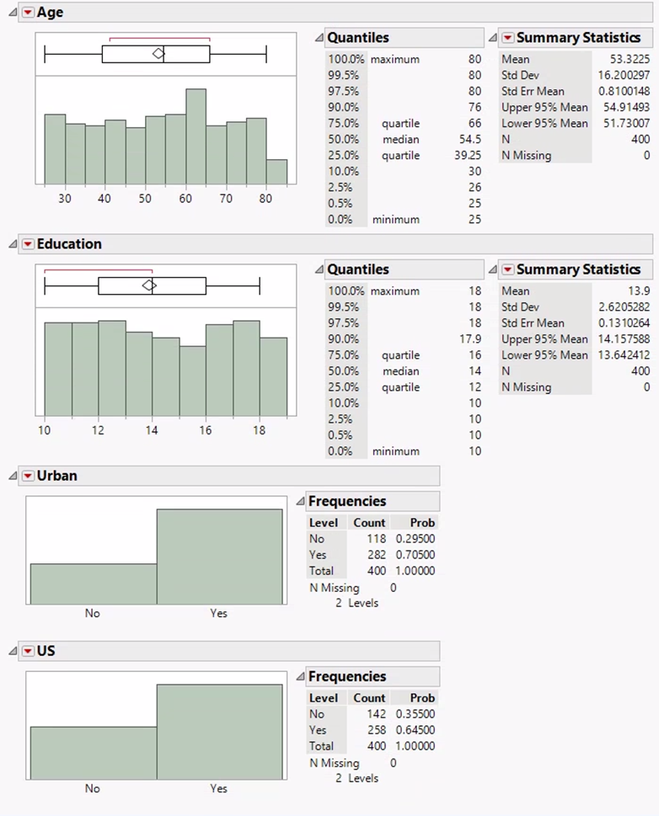
Summary Statistics
Histograms and summary statistics providing insights into the distribution of all variables in the dataset.
Most of the distributions are normal except for the variable Advertising where the distribution is right skewed.

Slide 16
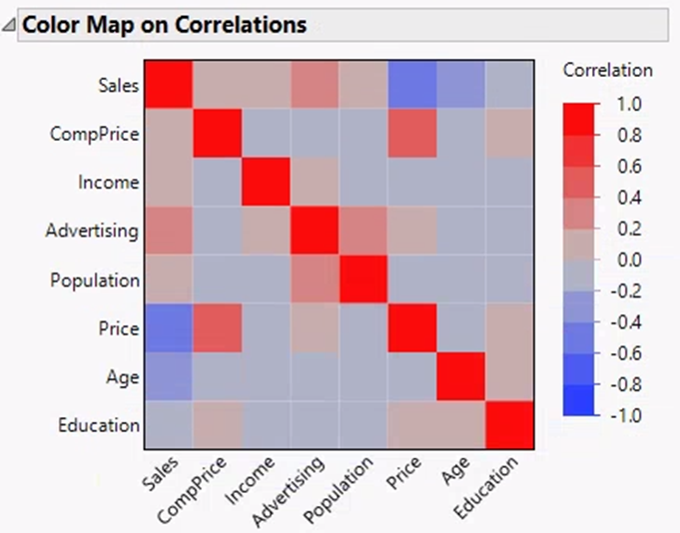
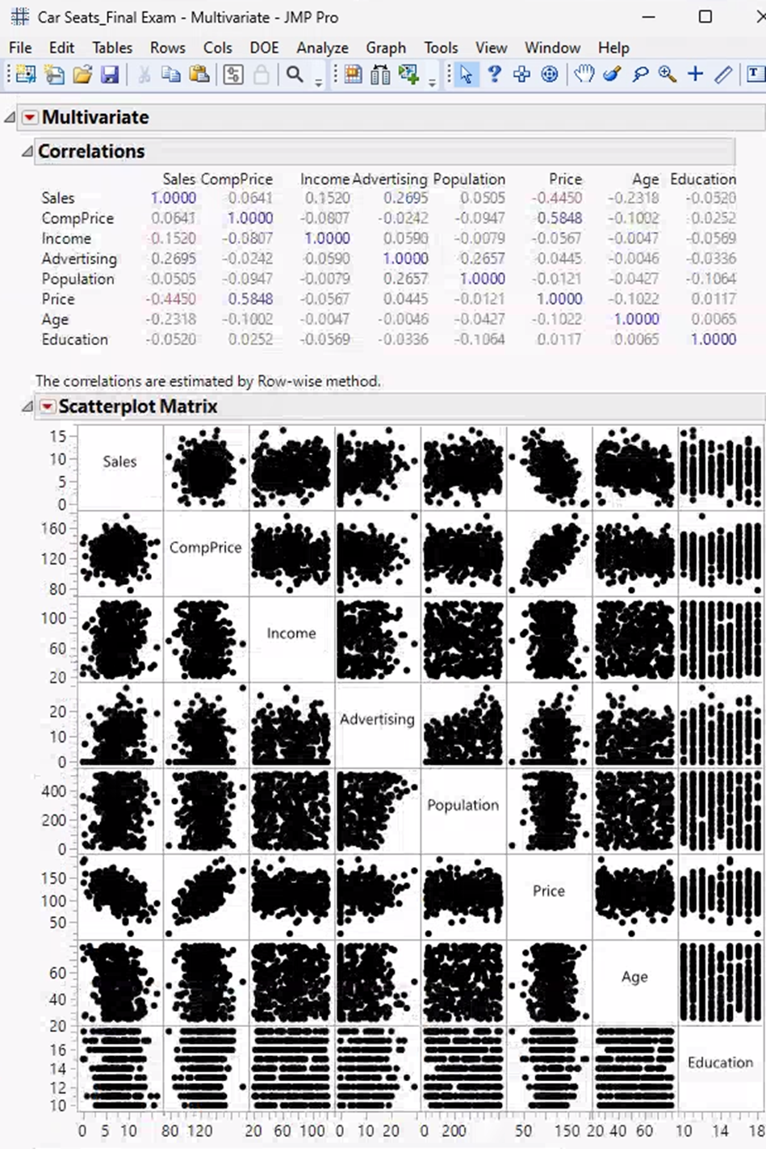
Heatmap showing the relationships with the response variable Sales.
Moderate to Strong positive relationship between Price and CompPrice.
Moderate to Strong negative relationship between Price and Sales.

Slide 17
Minimum AICc Stopping Rule
Using the Minimum AICc Stopping Rule, we obtained the same results as with using Minimum BIC as shown above in slide 9

Slide 18
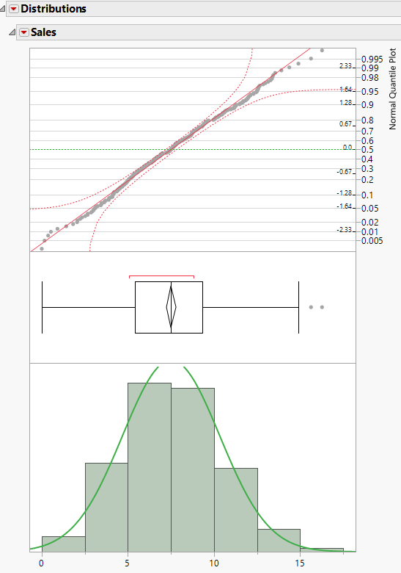
Model Distributions
Normal Quantile Plot
Residuals are within the two-confidence interval red colored lines. Thus, the assumption of normality is satisfied.
Notes:
Carolina

Slide 19
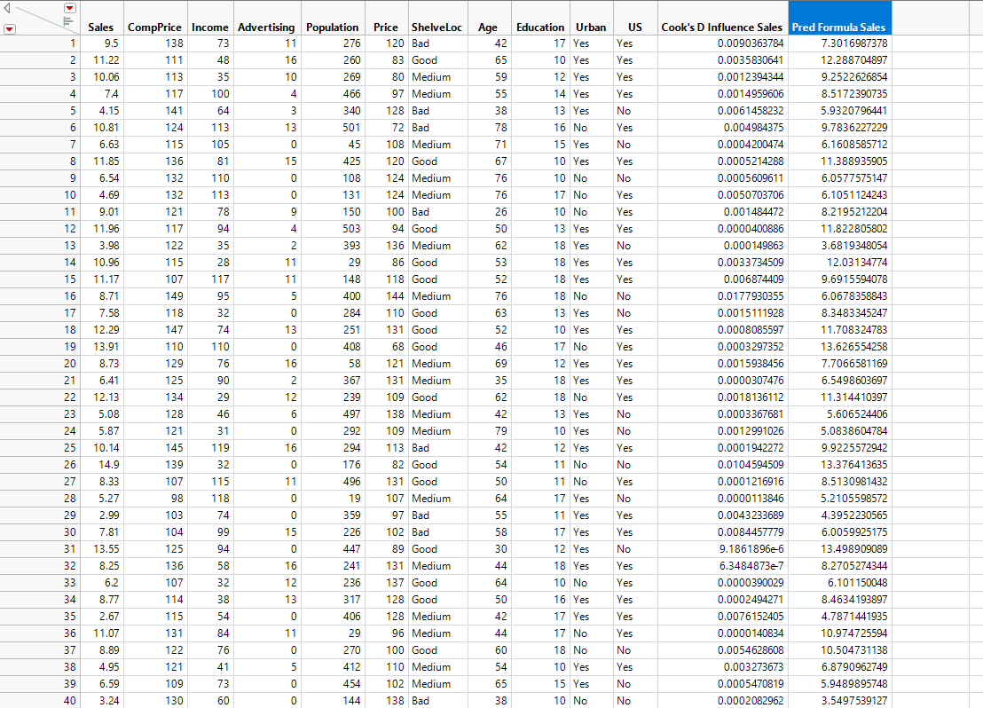
Prediction Expression Formula
Prediction expression formula applied to the dataset
Notes:
Carolina

Slide 20
References
Grayson, Jim, Gardner, Sam, and Stephens, Mia. 2015. Building Better Models with JMP Pro. Cary, NC: SAS Institute Inc.

